Slide 1

Predicting air quality due to wildfire smoke
John Wu
Notes:
Thank you for coming to my talk on presenting my Springboard capstone project: predicting air quality due to wildfire smoke.

Slide 2
The Problem
Wildfire smoke falls under particulate matter (PM).
PM2.5 from wildfire smoke is associated with premature deaths in the general population, and can cause and exacerbate diseases of the lungs, heart, brain/nervous system, skin, gut, kidney, eyes, nose and liver. --- WHO
Can we predict for how long after wildfires the air will remain dangerous?

Slide 3
Goal
We seek to predict the longevity of PM2.5, particulate matter most associated with wildfires (with diameters 2.5 micrometers or smaller).
We will look at weather station and air quality monitors around the San Francisco metro area from 2018 to 2019, and model on a time series regression problem.

Slide 4
Datasets
Merged Dataset: Jan 2018 – Dec 2019
Combined under closest longitude and latitude of air quality stations, so each weather station has an associated PM2.5
> 4,165,056 rows × 7 columns
> 221 unique locations
> 8 features, 1 label
Weather Stations
Source: Automated Surface Observing System
https://data.cdc.gov/browse/select_dataset?tags=pm2.5
> Hourly
> Temperature, humidity, wind direction, wind speed
> Key: Longitude and Latitude pair
Air Quality Stations
Source: Center for Disease Control
https://mesonet.agron.iastate.edu/ASOS/
> Daily
> Mean PM2.5 concentration
> Key: Longitude and Latitude pair
Notes:
The two datasets we will be looking at come from ASOS and the CDC. The main dataframe used for modeling combines hourly temp, humidity, wind direction, wind speed with daily mean pm2.5 concentration along the keys of longitude and latitude pairs. First, I did some cleaning of null data in ASOS as a small percentage of data was missing. Then I zipped the pair of long and lat and used the python library GeoPandas to find the closest matching air quality station to each weather station for the day.

Slide 5
Features and label
Label: DS_PM_pred': Mean estimated 24-hour average PM2.5 concentration in μg/m3
Features
'DS_PM_stdd': Standard error of the estimated PM2.5 concentration
'valid': timestamp of the observation
'lon','lat': longitude and latitude
'tmpf': Air Temperature in Fahrenheit
'relh': Relative Humidity in
'drct': Wind Direction in degrees from true north
'sped': Wind Speed in mph
Notes:
The following are the 8 features and the target variable of PM2.5.

Slide 6
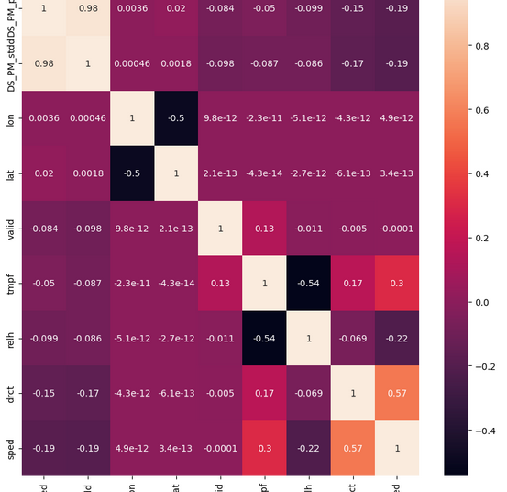
Exploratory Data Analysis
We look at a heat map of the correlation table of numerical features
‘DS_PM_pred’ is our target variable.
'DS_PM_stdd': Standard error of the estimated PM2.5 concentration is not a physical metric; it should be excluded.
There is higher anticorrelation with wind speed 'sped' and wind direction 'drct' than the time of the year in 'valid' and relative humidity 'relh’.
Latitude is more correlated than longitude by a (very) small order of magnitude.
Notes:
There is higher anticorrelation with wind speed 'sped' and wind direction 'drct' than the time of the year in the timestamp 'valid' and relative humidity 'relh'. This makes sense as we are not concerned with air quality in general, but the type of particle that is most associated with wildfires which can be blown in. Temperature 'tmpf' does not vary in extremes in the Bay Area where San Francsico is, so it makes sense that Summer (measured in 'valid') more than temperature impacts wildfires from further out in California.
• Latitude is more correlated than longitude by a (very) small order of magnitude. Some visual analysis of isolated of stations displayed "DS_PM_pred" as generally similar throughout all of the stations around San Francsico. However, latitude may place the station either in a geographical valley or closer to a wildfire. Given the mountains to the East, longitude may play less of a role as the air flow is blocked in those directions.

Slide 7
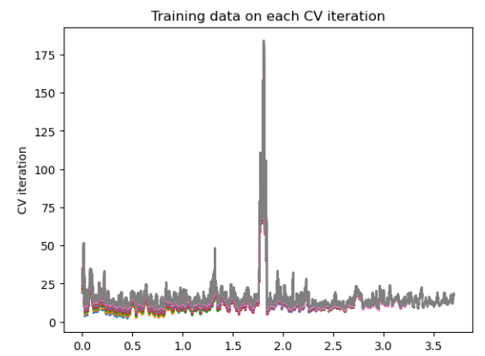
Visualizing the Time Series
Visualizing the cross validation split of the time series shows a large spike (time vs PM2.5, both standardized).
This has a historical explanation as the Camp Fire, which started on Thursday, November 8, 2018, in Northern California's Butte County.
This is 160 miles away from the air quality stations in San Francisco and was the deadliest wildfire in California history.
Notes:
Each color represents a different cross validation time split. The historical explanation of the spike was the Camp Fire, which happened 160 miles away from SF and was the deadliest in California history.

Slide 8
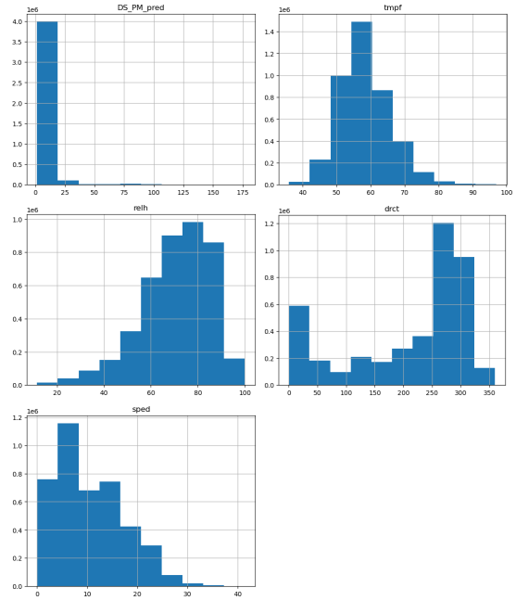
Frequency Distributions
For purposes of scaling, we look at the frequency distributions of the numerical features. A standard normal distribution is ideal.
'DS_PM_pred': We expect for the most part to be right skewed because of wildfires
'tmpf': This is almost normal and may just need scaling.
'relh': There is a slight left skew.
'drct': The wind direction may be default 0 when there is no wind speed.
'sped': There is a slight right skew
Notes:
'DS_PM_pred': We expect for the most part to be right skewed because of wildfire, while the majority of the data reflects safe air quality levels.
'tmpf': This is almost normal and may just need scaling.
'relh': There is a slight left skew.
'drct': The wind direction may be default 0 when there is no wind speed. Otherwise, as a coastal city, the wind direction remains one way most of the time.
'sped': There is a slight right skew.
I eventually settled on MinMaxScaler as that seems most useful for the LSTM model. StandardScaler and RobustScaler had little to no effect a test on an OLS model.

Slide 9
Modeling
The following models will be compared with similar set-ups:
Training-testing split via appropriate unshuffled split.
Min-max scaling
4 models
LSTM
Linear regression
Ridge regression
Lasso regression
Root mean squared error as comparison.

Slide 10
Regression Models
Each regression model (linear, ridge, lasso) implemented a similar pipeline
MinMaxScaler
$α$ = [0.001, 0.01, 0.1, 0, 1, 10]
𝛼 = [0.001, 0.01, 0.1, 0, 1, 10]
TimeSeriesSplit

Slide 11
LSTM Model
The simple LSTM model used an 80-20 train test split and a MinMaxScaler
40 epochs
50 node LSTM layer
Dense output layer

Slide 12
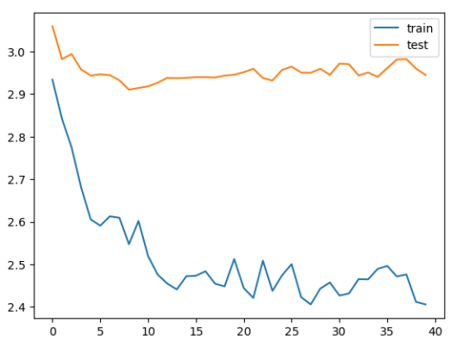
MAE Loss function for LSTM
Notes:
MAE is mean absolute error.
Although the training loss showed a steady decline, the testing loss stayed consistent. Adding different layers to make a deeper network is one way of making the loss match between the training and testing sets. An experiment was tried with a more complicated LSTM consisting of a convolution layer and drop out layers, but the training loss became worse while holding the testing loss at similar levels. This points to the lack of deeper features that the model can learn from and a preference for the initial simpler model.

Slide 13
Comparison
Model | RMSE
LSTM | 0.707
Lasso regression | 8.583
Ridge regression | 9.340
Linear regression | 9.340
Notes:
RMSE is the root mean squared error. Recall we want this metric to be as small as possible. There is no upper bound for this metric.

Slide 14
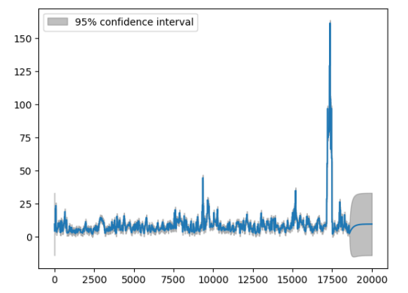
Recommendations on use
Given the same feature measurements, one could make a prediction for PM2.5 within a small timeframe using the LSTM model.
Even with a 1-dim ARIMA model, we can still make decent predictions with 95% confidence.
The data wrangling steps can be replicated on other state data from ASOS, so a model for other states can be easily derived from this one.

Slide 15
Next Steps
Although the relationship between the features and the label are non-linear, more can be done to predict for non-outliers.
Further steps like adding more layers to the LSTM, more parameters to the regression models, and other preprocessing methods can be applied. The ideal would be to get the RSME down to at most 0.5.
A larger scope can also be implemented, such as adding data from the rest of California. To really test the model's predictive power, we can look at data from other states as originally intended.
Part of doing this project was learning how to use AWS to do some of the computing. More can be done in the optimizing of this code as well as learning more about AWS
Notes:
Although the relationship between the features and the label are non-linear, more can be done to predict for non-outliers. For instance, the spike in PM 2.5 previous can be taken out and more time series analysis can be applied to find more seasonality in air quality.

